Slide 1
Unit 1
Algorithm and Programming Development

Slide 2
1. Program Development Life Cycle
The program development life cycle is a set of steps or phases that are used to develop a program in any programming language.
Problem Definition
Problem Analysis
Algorithm Development
Coding & Documentation
Testing & Debugging
Maintenance

Slide 3
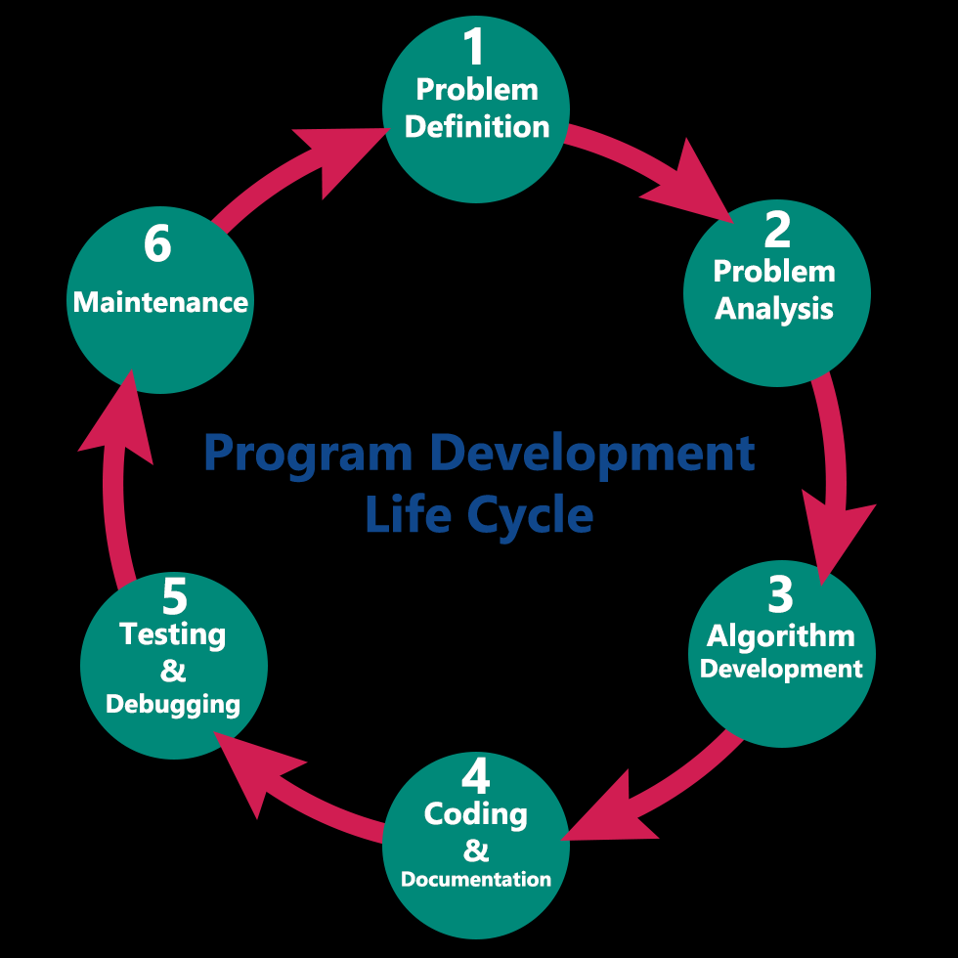

Slide 4
2. Flow charts and Algorithm development
Algorithm and flowchart are two types of tools to explain the process of a program.
Algorithm:: To write a logical step-by-step method to solve the problem is called algorithm, in other words, an algorithm is a procedure for solving problems. An algorithm includes calculations, reasoning and data processing. Algorithms can be presented by natural languages, pseudo code etc.
Flowchart:: A flowchart is the graphical or pictorial representation of an algorithm with the help of different symbols, shapes and arrows in order to demonstrate a process or a program.

Slide 5





Several standard graphics are applied in a flowchart:
Terminal Box - Start / End
Input / Output
Process / Instruction
Decision
Connector / Arrow

Slide 6
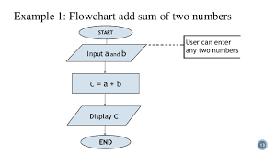
Algorithm Example 1: Write an algorithm to add two nos.
Step1: start
Step2: Read a, b
Step3: sum = a + b
Step4: write sum
Step5: stop

Slide 7
3. Program Debugging
Debugging is the process of locating and removing computer program bugs, errors, which is methodically handled by software programmers via debugging tools.
Debugging checks, detects and corrects errors or bugs to allow proper program operation according to set specifications.
A program may have bugs, or errors, so these bugs must be removed; a process called debugging.
Some bugs are easy to remove; others can be difficult. These bugs may appear at compile time and run time.

Slide 8
Problems
Write a algorithm for multiplication of 3 numbers.
Write a algorithm for division of 2 numbers.
Write a algorithm for finding greatest among 3 numbers.
Draw a flowchart for multiplication of 3 numbers.
Draw a flowchart for division of 2 numbers.
Draw a flowchart for finding greatest among 3 numbers.

Slide 9
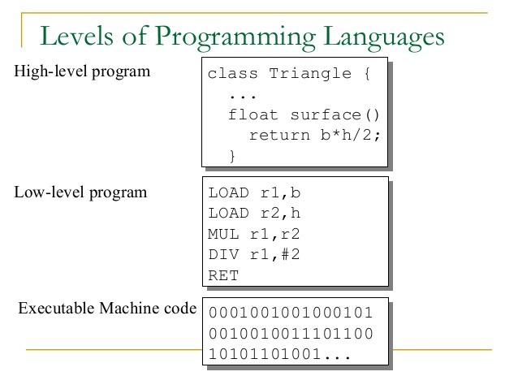
Computer languages

Slide 10
Computer languages
High level language: We generally write a computer program using a high-level language. A high-level language is one which is understandable by us humans. It contains words and phrases from the English (or other) language.
A program written in high-level language is called a source code.eg:- c,c++,java
Machine level language:: But a computer does not understand high-level language. It only understands program written in 0's and 1's in binary, called the machine code.

Slide 11
Low level language:: an assembly language is a low level language for microprocessors and other programmable devices.these are comparatively difficult to understand by user.
It works directly with the microprocessor
An assembly language is the most basic programming language available for any processor. With assembly language, a programmer works only with operations that are implemented directly on the physical CPU.

Slide 12
Compiler
We need to convert the source code into machine code and this is accomplished by compilers and interpreters.
Takes as input a source program typically written in a high level language and produces an equivalent target program typically in machine language.it compiles the whole program at the same time.

Slide 13
Interpreter
An interpreter is a program which translates statements of a program into machine code. It translates only one statement of the program at a time.
It reads only one statement of program, translates it and executes it. Then it reads the next statement of the program again translates it and executes it. In this way it proceeds further till all the statements are translated and executed.
If an error occurs, an interpreter stops execution and reports it.

Slide 14
Assembler
A program which translates an assembly language program into a machine language program is called an assembler.
An assembler translates assembly language programs into machine code.
The output of a assembler is called an object file, which contains a combination of machine instruction as well as the data required to place these instructions in memory.

Slide 15
Compiler
Interpreter
Compiler takes entire program as input.
Intermediate object code is generated.
Memory requirement is more since object code is generated.
A compiler is 5 to 25 times faster than an interpreter because program need not to be compiled every time.
The machine codes are saved permanently for future reference.
It takes single instruction as input.
No Intermediate object code is generated
Memory requirement is less because machine codes produced by interpreter are not saved.
Every time high level language is convert into low level program.
An interpreter is a small program as compared to compiler.

